Slide 1


Task Manager with Priority Scheduling
A Task Management System with Priority-Based Processing
Presented by: Harshit Arora
Domain: Software Development · Task Scheduling · Cloud Computing
Mentors: Palash Sir — Project Guidance | Ishita Ma'am — Cloud & Infrastructure Guidance
Notes:
1

Slide 2





About the Project
What Is It?
A Task Management System designed to create, manage, and process tasks efficiently. The system integrates a Priority Scheduling mechanism that determines execution order based on assigned task priority levels.
Core Idea
Long-term vision: Extend with asynchronous processing via Apache Kafka and deploy on cloud infrastructure.
Manage Tasks
Assign Priority
Schedule Tasks
Process Efficiently
Notes:
2

Slide 3




Current Project Status
The foundational layers of the system are complete and operational.
Basic Task Management
Priority Scheduling
Project Planning
Full CRUD operations implemented — tasks can be created, viewed, updated, and deleted reliably.
Priority levels integrated into the task model. The system processes higher-priority tasks before lower ones.
Project synopsis prepared. Future architecture and cloud implementation roadmap documented.
Status Summary: Core application + priority scheduling completed. Kafka integration and cloud deployment are the next milestones.
Notes:
3

Slide 4
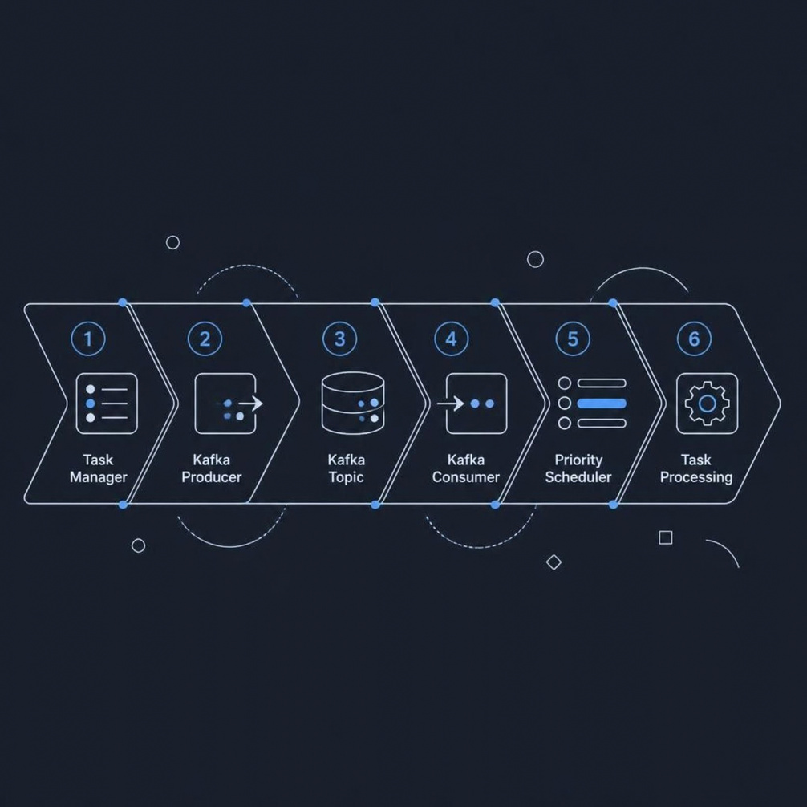
Current Focus: Apache Kafka
Why Kafka?
Apache Kafka introduces asynchronous, decoupled communication between system components, enabling scalable and resilient task processing.
Learning & Integration Stage
Kafka Fundamentals
Producer & Consumer Model
Understanding architecture, brokers, and cluster design
Learning how messages are published and consumed
Topic Design
Integration Planning
Structuring topics to fit the task-management flow
Evaluating the best approach to embed Kafka into the existing system
Notes:
4

Slide 5
Future Direction & Next Steps
Planned Development Roadmap
AWS Cloud Architecture (Planned)
CRUD Task Manager
1
EC2
RDS
✅ Complete
Application hosting
Managed database
2
Priority Scheduling
✅ Complete
S3
VPC & Security Groups
Kafka Integration
3
Object storage
Network isolation
🔄 In Progress
CloudWatch
Load Balancer
4
Asynchronous Task Processing
Monitoring & logs
Traffic distribution
🔜 Planned
Cloud Deployment
5
Cloud components represent the planned direction, not implemented features.
🔜 Planned
6
Monitoring & Scalability
🔜 Planned
Notes:
5

Slide 6





Potential Use Cases
The priority-based task processing model is applicable across a wide range of real-world systems.
Background Job Processing
E-Commerce Systems
DevOps / CI-CD
Report generation, batch data processing, and scheduled maintenance tasks.
Order processing, inventory updates, and customer notification workflows.
Build jobs, automated testing, and deployment-related task orchestration.
Notification Systems
General Task Processing
Email queues, push notifications, and background communication tasks.
Any multi-task system requiring differentiated priority-based execution.
These represent potential applications of the concept — the current project is a prototype exploring these ideas.
Notes:
6

Slide 7


Project Mentorship & Guidance
I am working collaboratively with both mentors to evaluate each phase and determine the most appropriate implementation approach as the project evolves.
Palash Sir — Project Mentor
Ishita Ma'am — Cloud & Infrastructure Mentor
Provides technical guidance on the overall project direction, helps evaluate implementation approaches, and supports decision-making for the next development steps.
Guides the cloud architecture exploration, AWS deployment strategy, and helps plan the future infrastructure and scalability roadmap.
Notes:
7

Slide 8
Thank You
Task Manager with Priority Scheduling — Harshit Arora
✅ CRUD Operations
✅ Priority Scheduling
✅ Project Synopsis
Complete
Complete
Complete
🔄 Kafka Integration
🔜 Cloud Deployment
In Progress
Planned
We welcome your questions, feedback, and suggestions.
Notes:
8

